Slide 1


Hospital Data Analysis
Project By : Bhushan Prabhakar Dhawas
Portfolio website : (Link)
Email : bdhawas0016@gmail.com

Slide 2
1
About Columbia Asia Hospital
Columbia Asia is a private, multinational chain of hospitals whose headquarter based in Kuala Lumpur, Malaysia, and operates primarily in Southeast Asia. Established in 1996, it has grown to 22 medical facilities across Malaysia, Vietnam, and Indonesia. It targets the middle-income group by setting up mid-sized hospitals in residential areas. Key services provided include general surgery, cardiology, neurology, pediatrics, obstetrics, orthopedics, trauma care, oncology, and internal medicine. Additional facilities include ICUs, neonatal care units, physiotherapy, laboratories, and pharmacies.

Slide 3
2
OVERVIEW
1. Introduction
5. Data Cleaning
9. Patient Info
2. Problem Aim
6. Insights
10. Recommendation
3. Data Overview
7. Main Tab
11. Conclusion
4. Methodology
8. Doctor Info
12. Thank You

Slide 4
3
Introduction to the Analysis
Purpose of the report: To provide insights into hospital operations , patient demographics, and doctor performance.
Tools used: Power BI.
Data focus areas: Revenue, satisfaction, patient visits, and performance metrics.

Slide 5
4
Project Aim
To evaluate the hospital's revenue generation, identify departments for potential new hires, and propose strategies for patient discounts to enhance efficiency and satisfaction.

Slide 6
5
Data Overview
Patient Race: The racial or ethnic background of the patient is recorded here, with categories such as 'White', 'African American', 'Asian', 'Native American/Alaska Native', and 'Two or More Races’.
Patient Admin Flag: This column contains boolean values ('TRUE' or 'FALSE') which might indicate whether the patient was admitted or some other administrative flag.
Patient Wait Time: Appears to indicate the time the patient waited, possibly in minutes, before being seen or processed.
Department Referral: This column lists the department to which the patient was referred, with entries such as 'General Practice', 'Orthopaedics', 'Gastroenterology', or 'None' indicating no referral.
Doctor Name: Identifies the doctor who attended each patient.
Appointment Fees: The cost charged for a doctor's consultation.
Total Bill: The overall amount billed to the patient, including all services and charges.
Date: This column contains date and time information without specifying AM or PM. The format is DD-MM-YYYY HH:MM.
Patient ID: Each patient is assigned a unique identifier, which seems to be in the format 124-62-3289.
Patient Gender: This column records the gender of the patient, denoted by 'M' for male and 'F' for female.
Patient Age: The age of the patients is listed in years.
Patient Sat Score: It seems to represent a satisfaction score given by or for the patient. However, the scores are single-digit, and it's not clear what the scale is.
Patient First Initial: This column contains the first initial of the patient's first name.
Patient Last Name: The surname of the patient is listed in this column.

Slide 7
6
Methodology
Data Loading and Transformation: Loaded data into Power BI, transformed it using Power Query, and performed data cleaning to ensure consistency and accuracy.
Measure Creation: Developed numerous measures using DAX functions, including calculated columns, filters, aggregation functions (SUMX), and time intelligence calculations.
Visualization Creation: Designed various visuals such as bar charts, column charts, cards, gauges, and pie charts to effectively present insights.
Dashboard and Interaction: Utilized features like edit interactions, slicers, and drill-throughs to create an interactive dashboard and comprehensive report.

Slide 8
7
Data Cleaning Process
Replaced null values in the Satisfaction Score column with the mean to ensure accurate analysis.
Created a Calendar Table from the date column and built a relationship model for time-based analysis.
Checked for null values across the dataset to identify and address data gaps.
Verified data types for consistency and ensured there were no errors in the columns.
Performed all cleaning tasks in Power Query, then applied the changes using the Close & Apply feature.

Slide 9
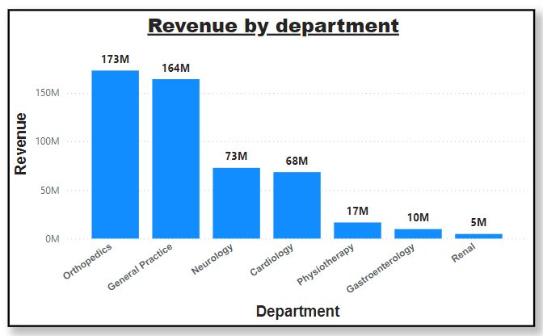
8
Total revenue by department
The Orthopedics Department recorded the highest total revenue among all departments, generating 173 million.
The Renal Department had the lowest total revenue, contributing just 5 million.

Slide 10
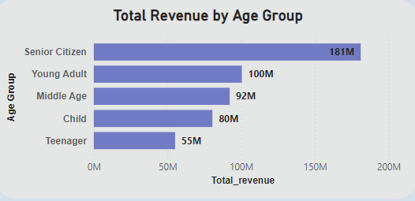
9
Total revenue by Age Group
The Senior Citizen group generate the highest revenue, totaling 181 million, followed by the Young Adult group with 100 million.
The lowest revenue was recorded in the Teenager group, contributing 55 million.

Slide 11
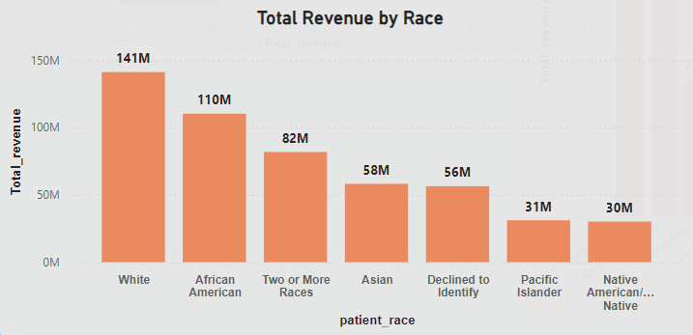
10
Total revenue by Race
The White race generated the highest revenue, contributing 141 million to the hospital revenue , followed by African Americans with 110 million.
The Native American demographic recorded the lowest revenue, contributing 30 million.

Slide 12
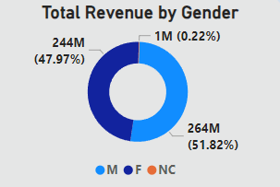
11
Total revenue by Gender
The Males generated the highest revenue, contributing 263.9 million (51.82%).
Followed by Females with 244.3 million (47.97%).
The NC (Not Categorized) category contributed the remaining 1 million.

Slide 13
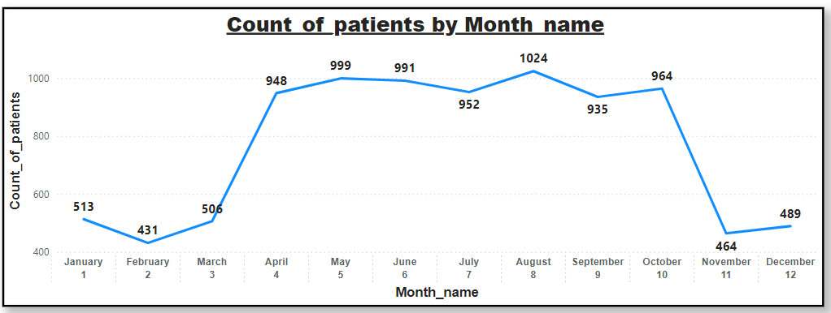
12
Patient Visit by Month
August was the month with the most visit(1024) and February was the month with the least(431).
There is a high volume of patients all through April to October and then a sharp decline in November.
Start of the year (January – March) and end of year (November – December) has low volume of patients.

Slide 14
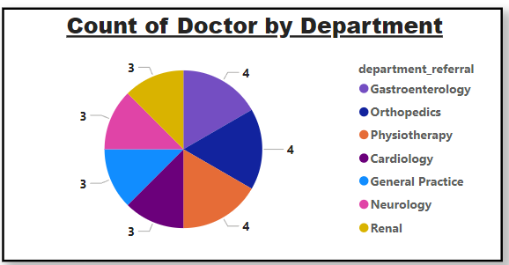
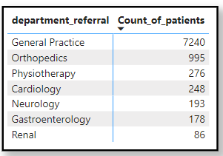
13
Count of Doctors by Department
General Practices gets the highest amount of visits with 7,240.
Even Orthopedics which comes in at 2nd place with 995 visits is no-where near that.
But General Practise Department have only 3 doctors.

Slide 15
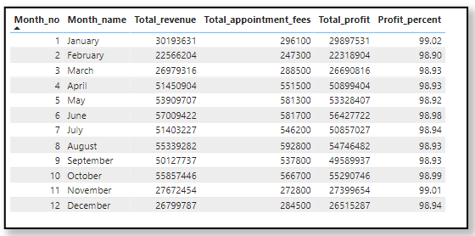
14
Hospital Profit
The Profit Percentage values were consistent, showing around 98.96% and 98.87%, indicating a very high profit margin.
The profit margin remains consistently high, well above 90%, which indicates the hospital is highly profitable.
Based on the profit percentage consistently being above 98%, it is clear that the hospital is highly profitable.

Slide 16
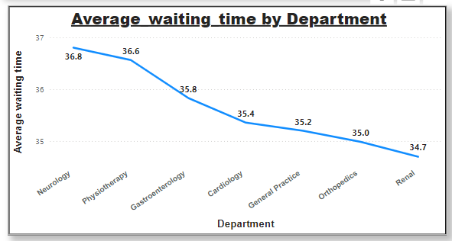
15
Avg Waiting by Department
The Neurology department had the highest average waiting time of 36.80 minutes, which stands out compared to other departments
All the departments have the average wait time between 34.70 minutes to 36.80 minutes which is approximately a 2.1 min of difference between the maximum and minimum.

Slide 17
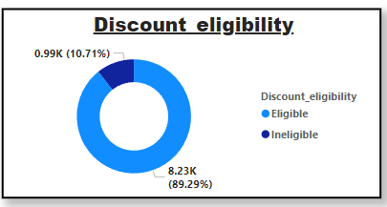
16
Discount Eligibility
Out of 9,216 patients, 12.46% are eligible for a discount, based on spending over 10,000.
The remaining 87.54% of patients are not eligible for the discount.

Slide 18
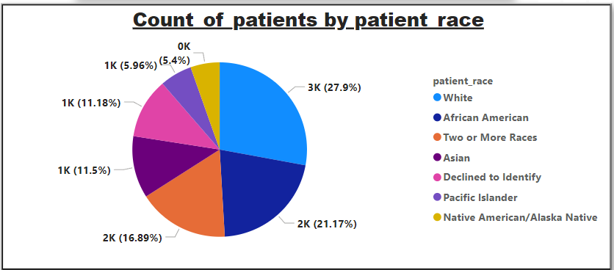
17
Count of Patients by Race
The other approx. 70% of our patient base is non-white.
White patients only account for around 27.9% of our total patient base.
African American (21.7%) has highest count, while Native American/ Alaska Native contribute 5.4%.

Slide 19
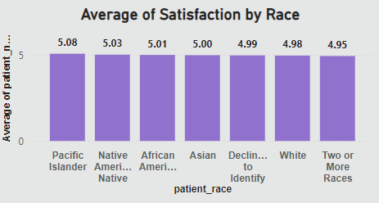
18
Avg Satisfaction by Race
The highest average satisfaction score is among Pacific Islanders at 5.08, followed by Native Americans at 5.03.
The lowest average satisfaction score is 4.95 from Two or more races .

Slide 20
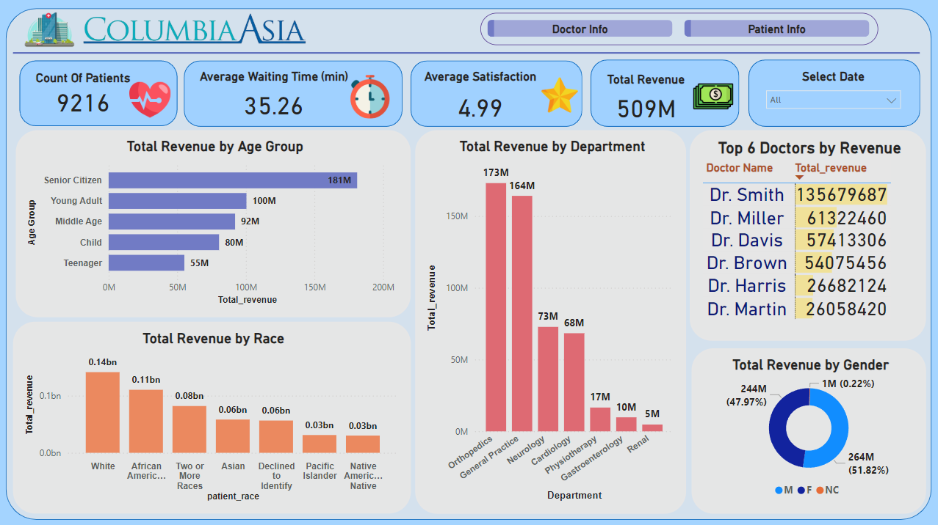
Main Tab
19

Slide 21
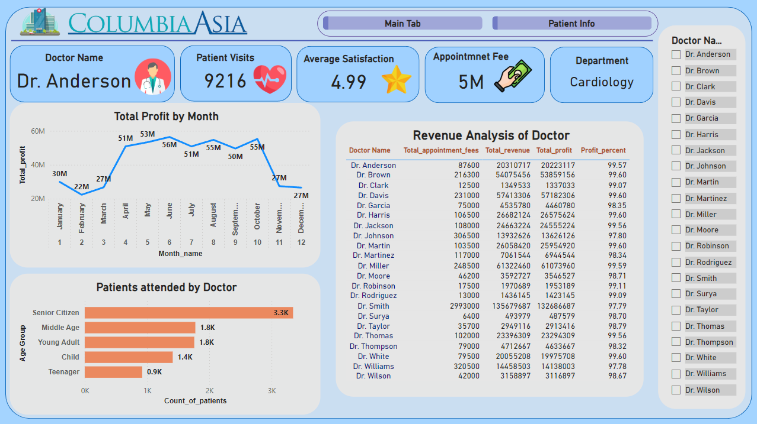
Doctor Info
20

Slide 22
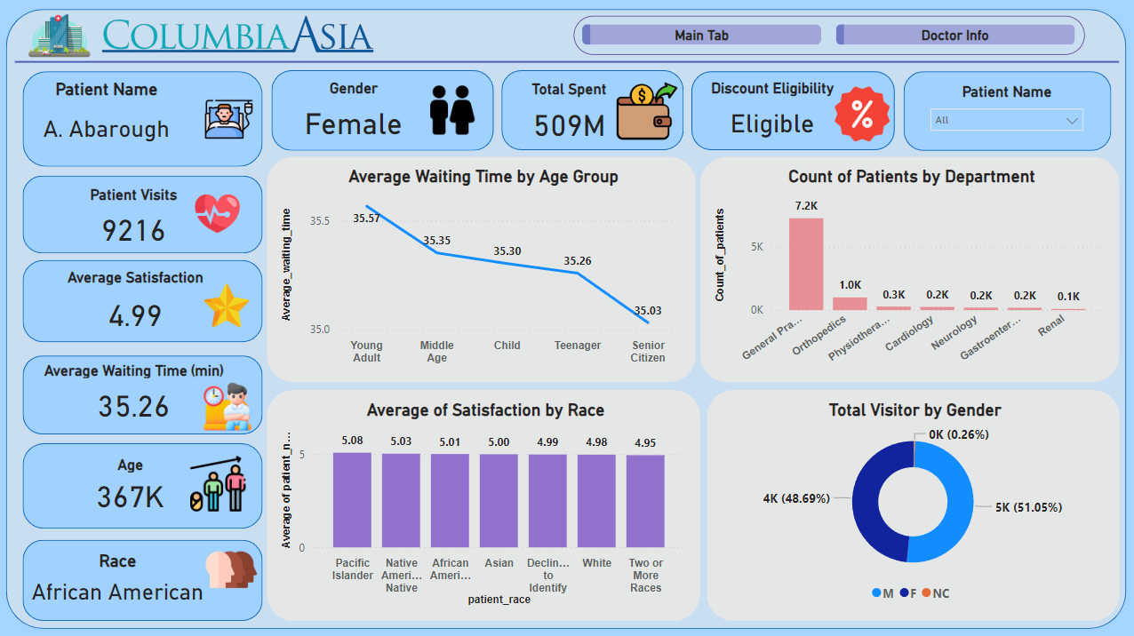
Patient Info
21

Slide 23
Recommendation
22
Optimize Staffing :
Targeted Discount Programs:
Allocate additional resources to high-traffic departments like General Practice, which accounts for the majority of patient visits. Hire at least two new doctors for this department to handle patient load effectively.
Offer discounts to patient groups contributing the most revenue, such as teenagers, to encourage loyalty and repeat visits . Additionally, provide discounts to patients whose total bills exceed ₹10,000 to incentivize high-value spending.
Seasonal Resource Planning:
Improve Patient Satisfaction Scores:
Adjust staffing and resources based on seasonal trends, with higher allocations during peak months (April–October) and optimized schedules during low-volume months (January–March, November–December).
Reduce waiting times in departments like Neurology, which has the highest average wait time, to enhance the overall patient experience.
Enhance Data-Driven Decision Making:
Maximize Revenue Opportunities:
Utilize demographic insights (age, race, gender) and KPIs (revenue, satisfaction, waiting times) to tailor services and optimize departmental performance.
Address underperforming departments, such as Renal, by analyzing contributing factors and implementing improvement plans.

Slide 24
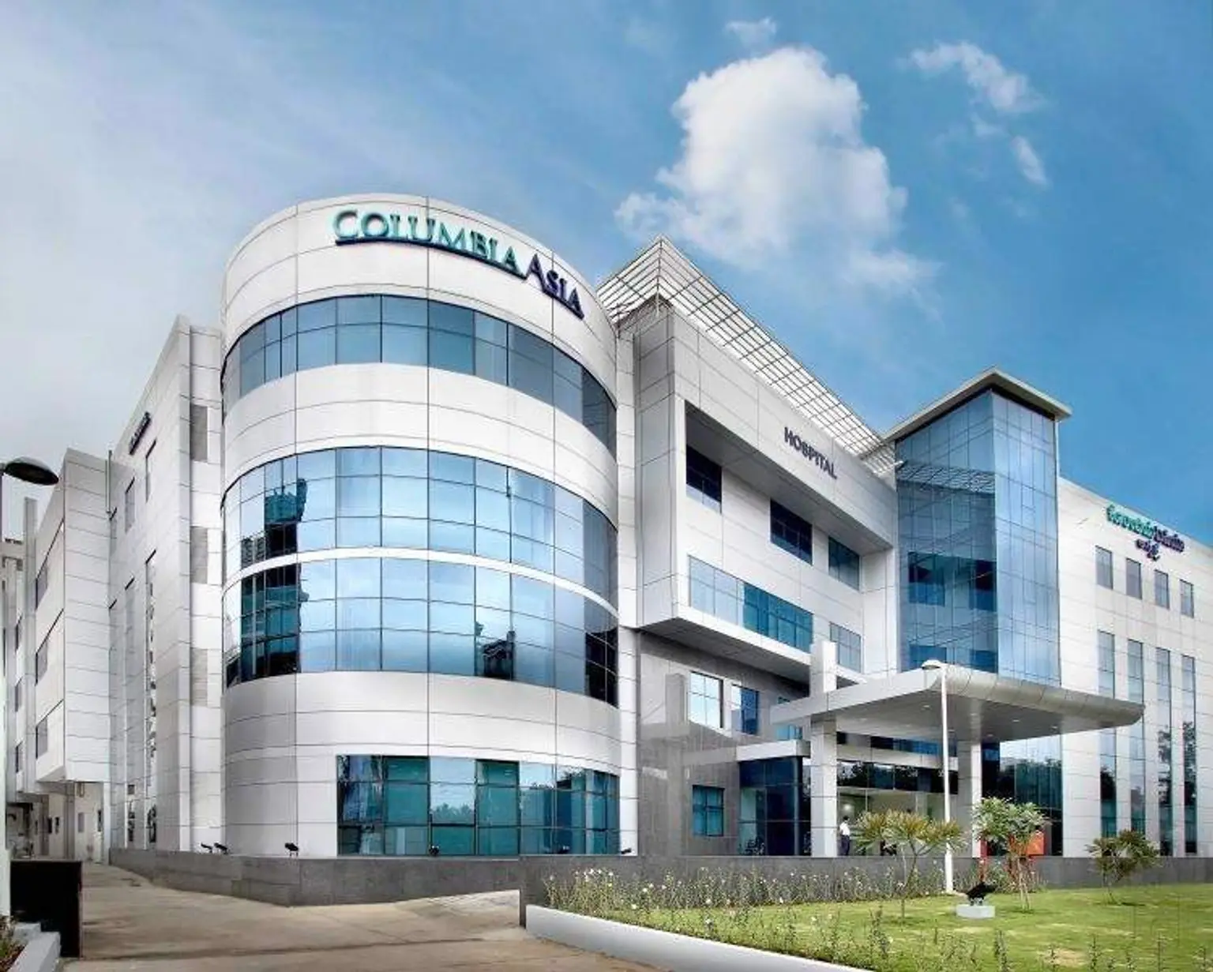
23
CONCLUSION
The analysis of Columbia Asia Hospital identifies key revenue drivers, with Orthopedics leading in revenue and General Practice as the top choice for new hires. Additionally, there is potential to increase patient discount eligibility, currently at 12.46%, to enhance patient satisfaction.

Slide 25
THANK YOU
Project By : Bhushan Dhawas
Portfolio website : (Link)
Email : bdhawas0016@gmail.com
Mobile no. – 9075252543
LinkedIn : (Link)

